Slide 1

Hey, You, Get Off of My Cloud:
Exploring Information Leakage in Third-Party Compute Clouds
CCS '09: Proceedings of the 16th ACM conference on Computer and communications security
November 2009
Authors:
Thomas Ristenpart
Eran Tromer
Hovav Shacham
Stefan Savage
Presenters:
Deniz Aytemiz
Vikas Krishnan Radhakrishnan

Slide 2
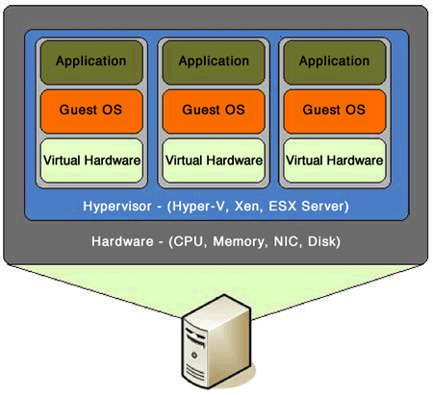
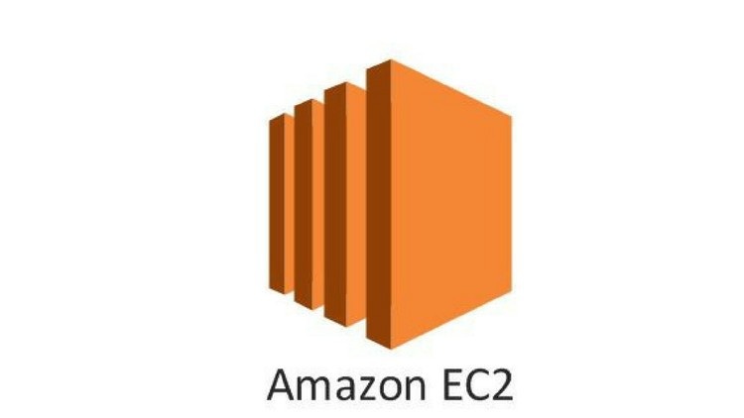
What is this work about?
This paper is a case study of Amazon EC2.
Amazon EC2 is a third party cloud computing service where you can instantiate Virtual Machines.
Identifying the location of a target VM in the cloud.
Instantiating co-resident VM with the target VM to enable side-channel attacks.
Image source: http://cis2.oc.ctc.edu/oc_apps/Westlund/xbook/xbook.php?unit=11&proc=page&numb=3

Slide 3
Outline
Introduction
Threat Model
EC2 Service
Network Probing
Cloud Cartography
Determining Co-residence
Exploiting Placement in EC2
Cross-VM Information Leakage
Conclusion & Discussion
Can one determine where in the cloud infrastructure an instance is located?
Can an adversary exploit cross-VM information leakage once co-resident?
Can an adversary launch instances that will be co-resident with other user’s instances?
Can one easily determine if two instances are co-resident on the same physical machine?

Slide 4
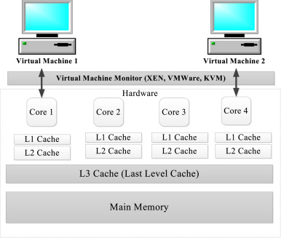
Introduction
Multiplexing: Two or more disjoint VMs sharing the same physical structure. (e.g. CPUs cache)
Multiplexing VMs enables cross-VM side channel attacks
Image source: https://www.semanticscholar.org/paper/Scalable-virtual-machine-multiplexing-Gupta/ec29764f93fab42fd4b7bb6d8fca9f1bced19c97

Slide 5
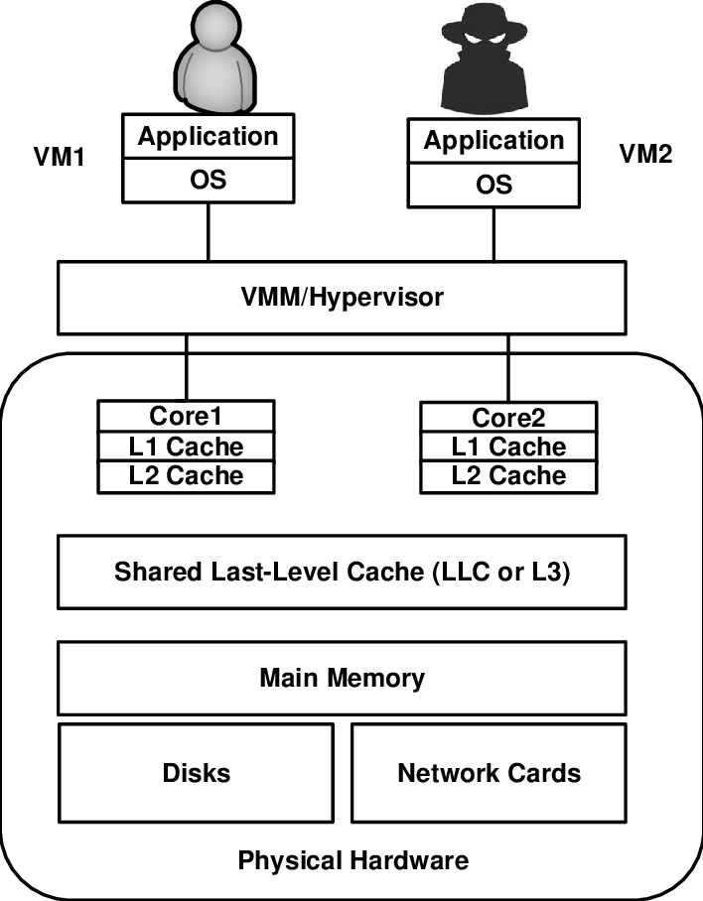
Why is Multiplexing VMs Good AND Bad?
Maximizes efficiency
Attack case: Information leakage due to sharing of physical resources
Hypervisor provides isolation between VMs and intermediate access to physical hardware.
Image source: https://www.researchgate.net/figure/Cross-VM-side-channel-attack-using-a-shared-last-level-cache_fig2_327314423

Slide 6

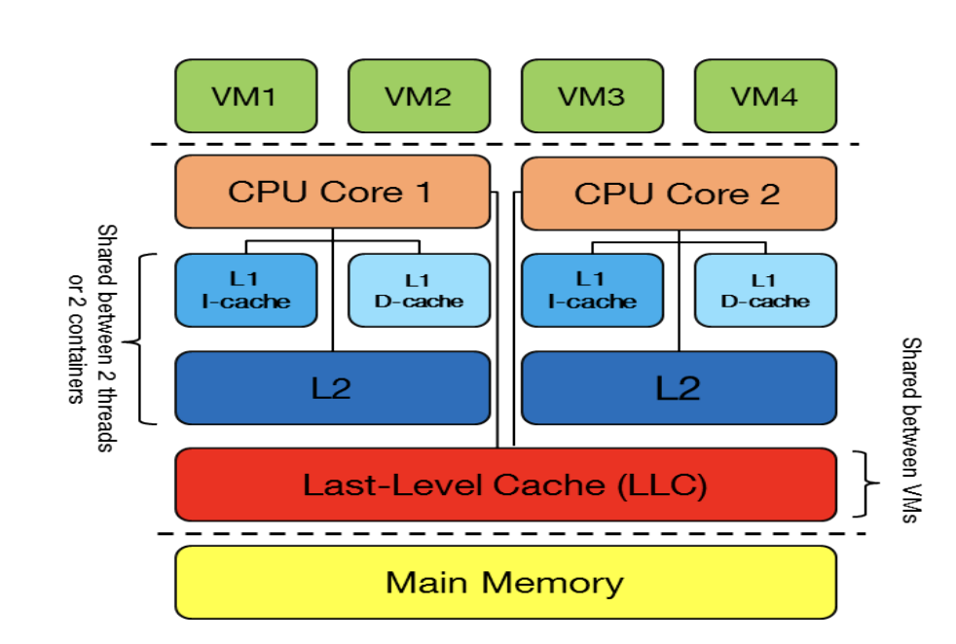
Threat Model
Only external attackers are considered in this work!
Attacks involve two steps:
Place malicious VM in the same physical hardware as the target VM.
Extract confidential information from target VM through side channels.
Attack to some known hosted service
Attack to a particular victim service
Third party cloud computing implicitly increases attack surface.
Image source:https://hal.inria.fr/hal-01591808/document

Slide 7
How relevant is this work and its results to the present?
This work is from late 2008/2009
Nascent hyperscale applications then!
Everything is cloudified now!
With that in mind, let’s revisit the origins of cloud security…

Slide 8


EC2 Service
“Third-party cloud computing platform” (IaaS)
Xen hypervisor (now known as Citrix hypervisor)
Guest VM: Linux, FreeBSD, OpenSolaris, Windows
Domain0 → privileged VM to manage guest VMs
How to use EC2?
Register with EC2:
Create Account with contact
Email ID and CC information
Choose: Region
↓
Availability Zone
↓
Instance Type
Create a VM image
↓
Deploy on EC2 → instance

Slide 9
EC2 Infrastructure Availability
Regions: United States, Europe
Availability Zones: 3 per region → Zone 1, Zone 2, Zone 3
Instance Types (for Linux instance images in the US Region):
Instance Type | CPU Architecture | Instance Capability | Cost/Hour
m1.small | 32-bit | 1 vCPU, 1.7 GB memory, 160 GB storage | $0.10
c1.medium | 32-bit | 2 vCPUs, 1.7 GB memory, 350 GB storage | NA
m1.large | 64-bit | 2 vCPUs, 7.5 GB memory, 850 GB storage | $0.40
m1.xlarge | 64-bit | 4 vCPUs, 15 GB memory, 1680 GB storage | NA
c1.xlarge | 64-bit | 8 vCPUs, 7 GB memory, 1680 GB storage | NA
Source: .https://aws.amazon.com/ec2/previous-generation/

Slide 10


Network Probing
nmap → liveness probe (TCP Connect) to detect EC2 instances
hping → traceroute (iterative TCP SYN with increasing TTLs until no ACK) to determine co-resident VM placement
wget → retrieve web pages to establish public webserving target VMs in EC2
To estimate the VM placement pattern in the EC2 system
Used later to determine co-residence of an adversarial VM with a target VM
Network Probes
External Probes
Originates outside EC2 via external IP
Internal Probes
Originates within EC2 via internal IP

Slide 11
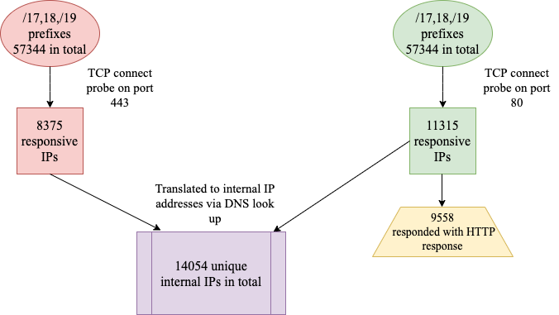
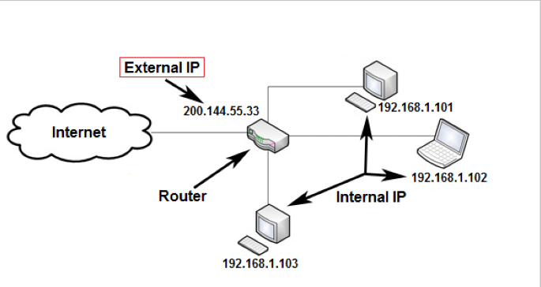
Cloud Cartography:
Mapping
Experiment Conducted:
/16,/17,/18,/19 IPv4 prefixes associated with EC2
Enumerating public EC2-based web servers using external probes & translating responsive public IPs to internal IPs
Surveying public servers on EC2
Image source: https://troypoint.com/internal-external-ip-address/

Slide 12
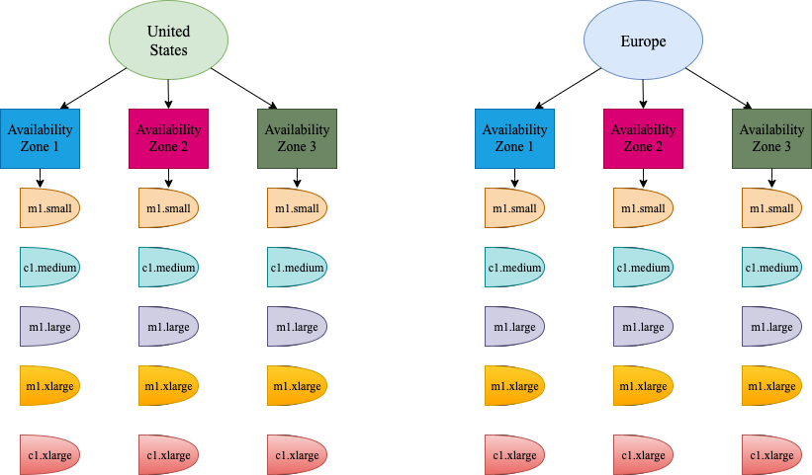
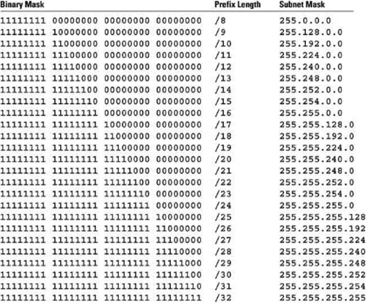
Cloud Cartography:Mapping
2. Instance Placement parameters
Account A:
20 instances for each, 300 in total.
Image source: https://www.benq.com/en-ap/business/support/faqs/application/publicdisplay-b2bfaq-k-00034.html

Slide 13
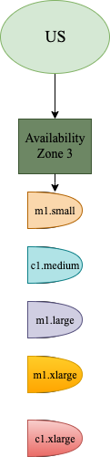
Cloud Cartography
2. Instance Placement parameters
Account B:
20 instances for each, 100 in total.
Created 39 hours after terminating account A.

Slide 14
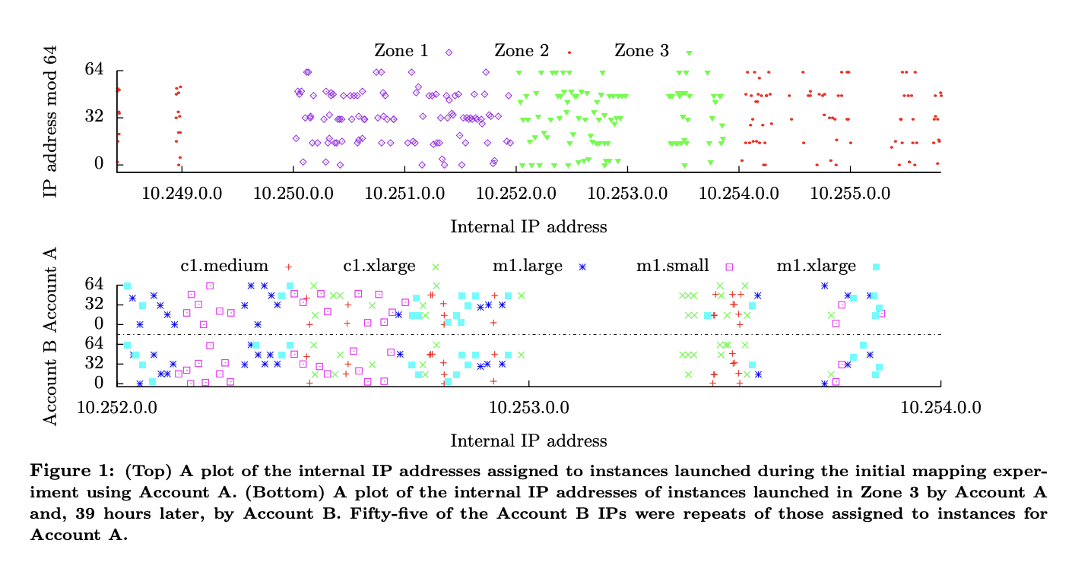
Cloud Cartography: Results/ Fuller Map of EC2
Results/ Fuller Map of EC2

Slide 15
Cloud Cartography: Results/ Fuller Map of EC2
No IP addresses were ever observed being assigned to more than one instance type.
All IPs from /16 are from same availability zone.
A /24 prefix inherits any included sampled instance type.
A /24 containing a Dom 0 IP address only contains Dom 0 IP addresses.
All /24’s between two consecutive Dom 0 /24 inherit the former’s associated type.

Slide 16
Cloud Cartography: Results/ Fuller Map of EC2
869 /24 s in total
Unique zone and type assigned to 723 of them
Unique zone and two types assigned to 23 of these
123 left unlabeled

Slide 17
How to determine
Co-residence of
VM Instances?
1.
Matching Dom0 IP Address
Network-based co-residence checks
Instance’s first hop is Dom0
Probe instance for Round Trip Time (RTT)
Use average RTT for 10 probes
Map internal IPs to Dom0 IP subnet
If IPs are close → co-resident instances
How to confirm co-residence?
Cross-VM covert channels
Hard disk-based
CO-
RESIDENT
VMs
2.
Small Packet RTT
3. Numerically Close Internal IP

Slide 18
Co-residence Check
Use 3 EC2 accounts
Control → Test RTT
Probe → Attacker
Victim → Target
Test covert channel
Launch instances
Send a 5-bit message from Victim to Probe over the hard-drive covert channel
Control → 2 in all zones
Probe → 20 in Zone 3
Victim → 20 in Zone 3
Probe for RTT
Check Dom0 IP
Check RTT for probes between Probe and Victim, and both to the Control instances
For each ordered pair of Probe and Victim instances, check if Dom0 IPs are the same

Slide 19
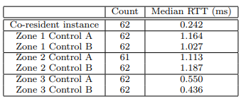
Co-residence Check
(contd.)
Compare internal IP of instances for numerical closeness
Figure 2: Median round trip times in seconds for probes sent during the 62 co-residence checks. (A probe to Zone 2 Control A timed out.)
Perform TCP SYN traceroute on an open port on the target
1
3
Check for a single hop through Dom0 IP address
2
4
The Probe instance is co-resident with the Target!

Slide 20


Exploiting Placement in EC2:
Brute-Forcing Placement
Attacker enumerates a set of potential targets
Attacker enumerates a set of potential targets
Attacker infers which of these targets belong to which availability zone and instance type by using the map
Attacker runs probe instances repeatedly in the target zone and of target type.
Each probe instances check co-residence and if not the instance is terminated quickly.

Slide 21
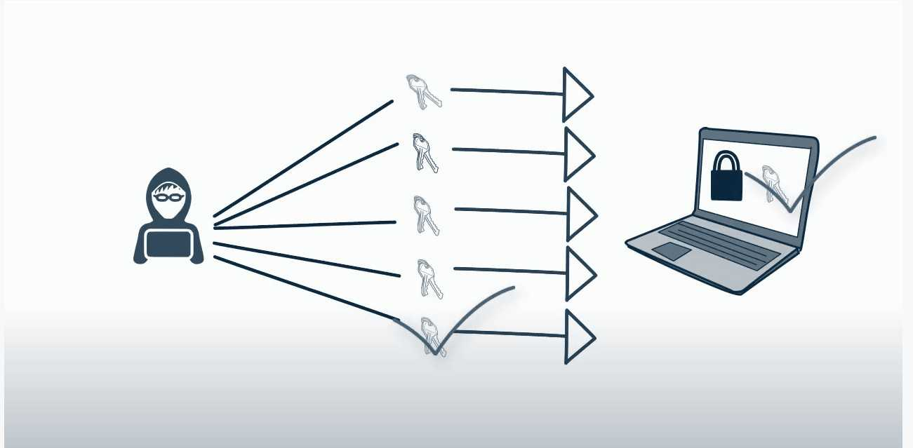
Exploiting Placement in EC2:
Results of Brute Forcing Strategy
1686 servers with zone 3 and m1.small instance type
1686 servers with zone 3 and m1.small instance type
Achieved co-residency in 141 victim servers = 8.4% success rate
Analyzed 1785 probe instances
With 78 unique Dom 0 IPs

Slide 22
Exploiting Placement in EC2:
Abusing Placement Locality
Parallel placement locality
Instance flooding: running multiple instances in parallel.
Effect of time, account or zone?
Effect of increased time lag?

Slide 23
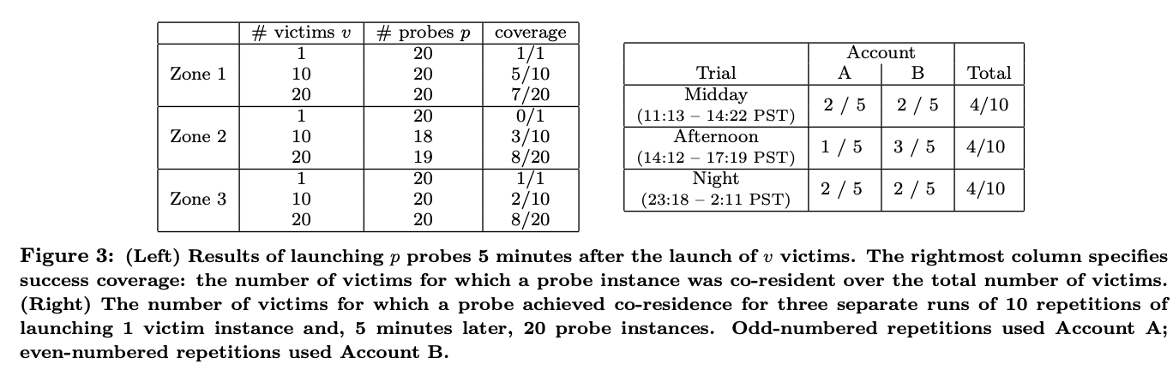
Exploiting Placement in EC2: Abusing Placement Locality (contd.)
40% success rate
M1.small instance type used for this experiment.
Availability zone does not meaningfully affect co-residency rates.

Slide 24
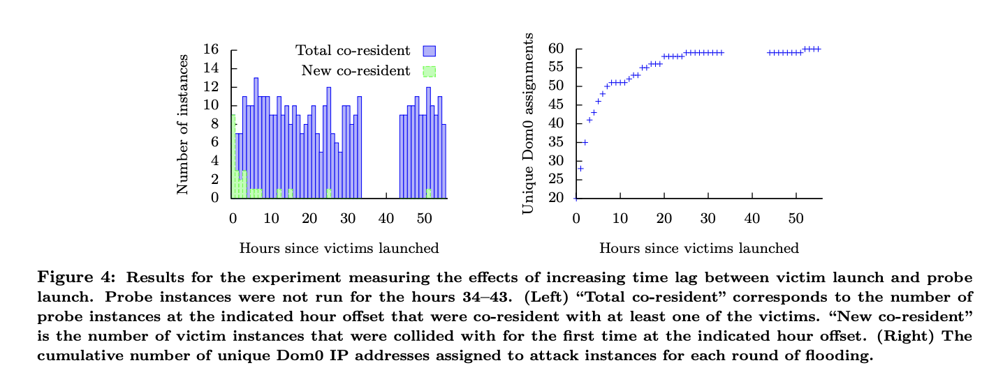
Exploiting Placement in EC2: Results of Abusing Placement Locality

Slide 25
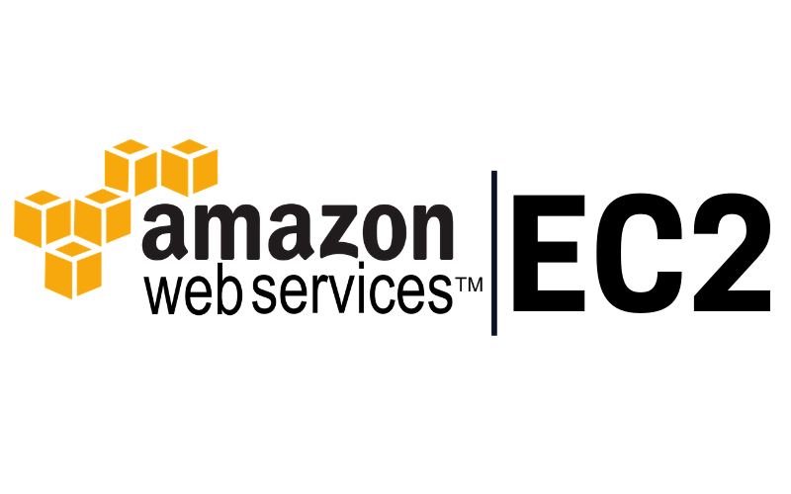
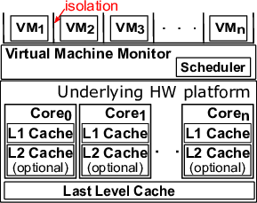
Exploiting Placement in EC2:
Patching Placement Vulnerabilities
Inhibit cartography
Inhibit co-residence checking
Offload placement choice to users
Image source: https://www.researchgate.net/figure/Isolation-in-a-virtualized-environment_fig1_292139909

Slide 26

Cross-VM Information Leakage
Exploit side-channels to learn information about co-resident instances.
Time-shared caches can leak information about computational load
Side-channel applications explored:
Robust co-residence detection (agnostic to network configuration)
Surreptitious detection of web traffic rates on a co-resident victim instance
Timing keystrokes by an unsuspecting user accessing a co-resident instance via SSH
Studied on an EC2-like virtualized environment
Coarse-grained side channel attacks!
No ability to extract cryptographic keys :(
Extract less bits of information :|
More robust; simpler to implement in noisy environments :)

Slide 27
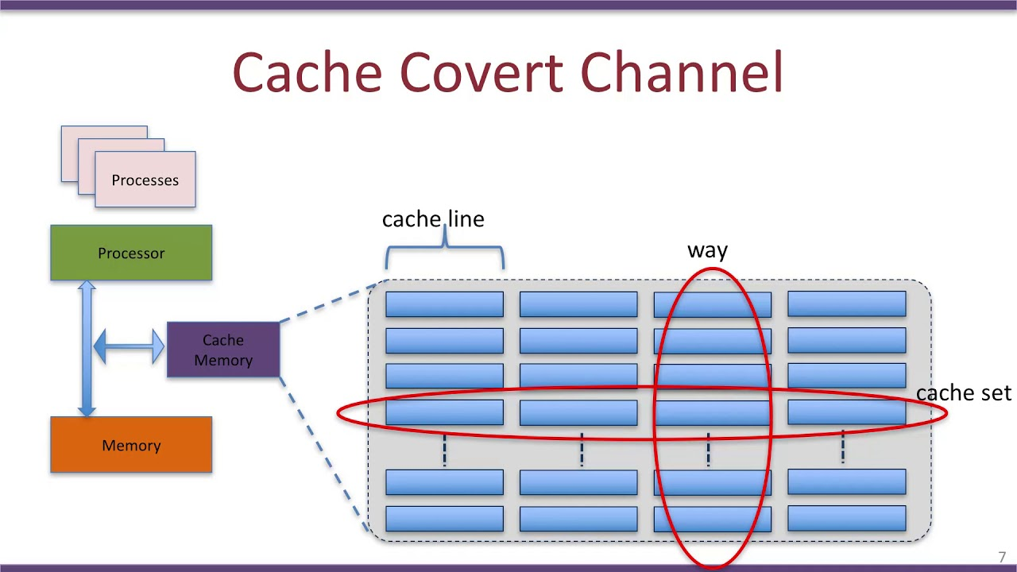
How to Orchestrate Cross-VM Side-Channel Attacks?
Image source: https://www.youtube.com/watch?v=RmJ4E4OwKXY (thumbnail)

Slide 28
CPU Load Measurement: Prime+Trigger+Probe
Cache utilization → good indicator of CPU load → activity in co-resident instances
Exploit statistical delay in cache miss times to establish covert channel.
Contiguous buffer B (b bytes) → b ≈ cache size; Cache line size (s bytes)
Probe
Trigger
Prime
Busy-loop until the CPU’s cycle counter jumps by a large value.
Measure the time it takes to again read B at s-byte offsets.
Read B at s-byte offsets in order to ensure it is cached.
3
1
2

Slide 29
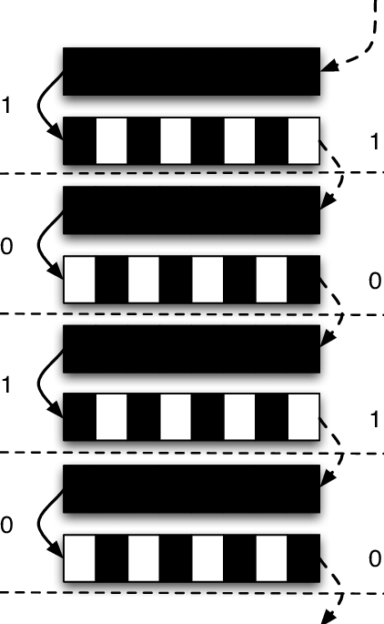
Enhanced P+T+P
Technique
Use differential coding for noise resilience
Cache partitioning into associativity sets
“Odd sets” and “even sets”
Three parameters:
a → larger than attacked cache level
b → slightly smaller than attacked cache level
d → n² * (cache line size)
Even addresses → addresses == 0 mod 2d
Odd addresses → addresses == d mod 2d
Image source: https://www.researchgate.net/figure/An-illustration-of-a-covert-channel-using-L2-cImage ache-to-encode-information-For-each-bit_fig2_221609235

Slide 30
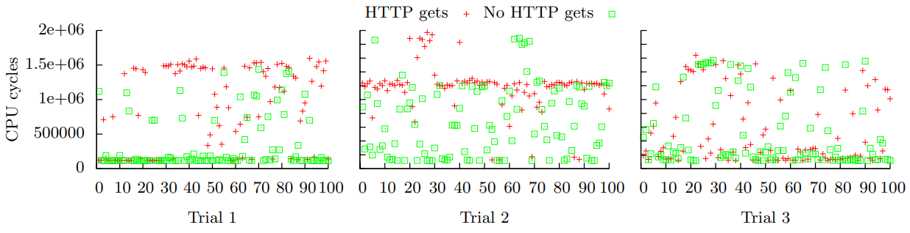
Load-based Co-residence Detection
Setup: m1.small instances, Fedora Core 4 with Apache 2.0, 1024 byte text-only HTML page
Attacker VM takes 100 load samples (b= 768 * 1024, s = 128); ≈ 12 seconds
Pause for 10 seconds
Repeat 1 while making HTTP GET requests to the Target VM via jmeter 2.3.4 (100 user threads)
Figure 5: Results of executing 100 Prime+Trigger+Probe cache timing measurements for three pairs of m1.small instances, both when concurrently making HTTP get requests and when not. Instances in Trial 1 and Trial 2 were co-resident on distinct physical machines. Instances in Trial 3 were not co-resident.

Slide 31
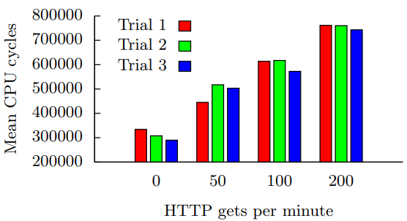
Estimating Traffic Rates
Experiment Setup:
Two m1.small instances
Four separate runs of 1000 cache load measurements
1000 measurements ≈ 90 seconds
Requested web page: 3 MB text file
jmeter with 20 users requesting
Vary HTTP requests in each run:
No HTTP requests sent
HTTP requests sent @ 50 per minute
HTTP requests sent @ 100 per minute
HTTP requests sent @ 200 per minute
Experiment repeated thrice; results averaged
Figure 6: Mean cache load measurement timings (over 1 000 samples) taken while differing rates of web requests were made to a 3 megabyte text file hosted by a co-resident web server.

Slide 32
Keystroke Timing Attack
Experiment Environment: Local testbed with EC2-like configuration
Opteron CPUs, Xen hypervisor
Linux kernels similar to EC2-hosted m1.small instances
VMs pinned to specific cores → no migration between vCPUs
Machine completely idle other than test code
Ability to discern relation between VMs involved in the attack (e.g time-shared cores or not)
Keystrokes detected using simple thresholding
E.g. reporting a keystroke when the probing measurement is between 3.1 µs and 9 µs
Variants can exploit either L1 or L2 cache contention
Attacker can observe a clear signal with 5% missed keystrokes & 0.3 false triggers/s
Timing resolution ≈ 13 ms

Slide 33
Inhibiting Side-channel Attacks:
Key Takeaways
Blinding techniques → minimize leakable information
E.g. cache wiping, random delay insertion, adjusting perception of time at each instance, etc.
Consider countermeasures to side-channel attacks
Difficult for practical implementation
High overhead of implementation or requires using non-standard hardware
Application-specific, or insufficient for complete risk mitigation
Requires discovery, anticipation, and patchability of all possible side-channels :(
AVOIDING co-residence, based on the current state of the art.
But… What is the current state of the art (in 2022?!)

Slide 34
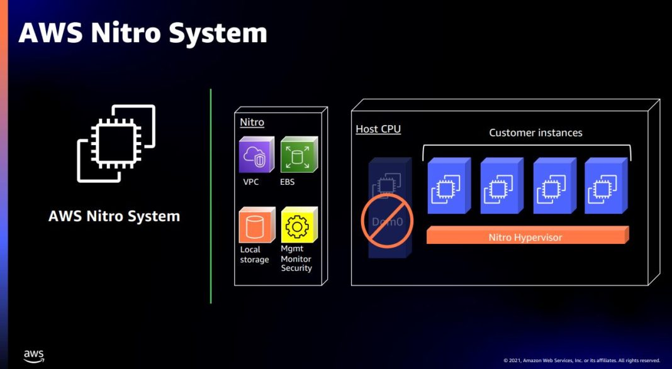
AWS EC2 Infrastructure
(Present)
Regions
Availability Zones
Local Zones
Wavelength Zones
AWS Outposts
Image source: https://www.servethehome.com/aws-nitro-the-big-cloud-dpu-deployment-detailed/

Slide 35
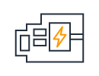
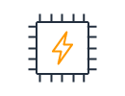

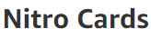
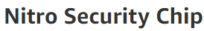
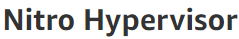


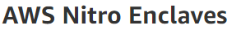
AWS Nitro System: Key Features
Source: https://aws.amazon.com/ec2/nitro/

Slide 36
AWS EC2: Current Instance Types
Source: https://aws.amazon.com/ec2/instance-types/

Slide 37
Conclusion & Discussion
Obfuscate internal structure of cloud infrastructure
Adopt an obscure/non-predictable instance placement policies
Inhibit simple network-based co-residence checks
Reduce the attack surface for side-channel vulnerabilities
Employ blinding techniques minimize information leakage
Expose any unmitigable risk to the user
Provide placement decisions directly to the users (dedicated resources)

Slide 38

Questions?
Thank you!

